Slide 1
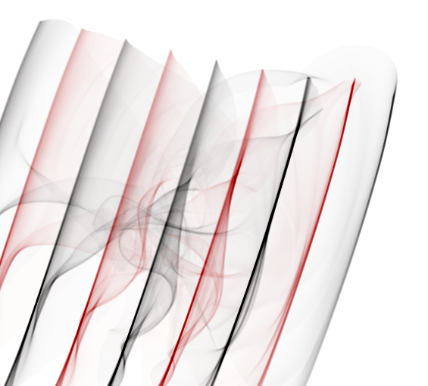
21.08.02
NordBioNet Summer School 2021 Proteogenomics Workshop
Marc Vaudel
Center for Medical Genetics and Molecular Medicine, Haukeland University Hospital, Bergen, Norway
Center for Diabetes Research, Department of Clinical Science, University of Bergen, Norway
Unfold05 Thomas Lin Pedersen
Notes:
Artwork: unfold05 by Thomas Lin Pedersen (www.data-imaginist.com/art)

Slide 2
Why proteogenomics?

Slide 3
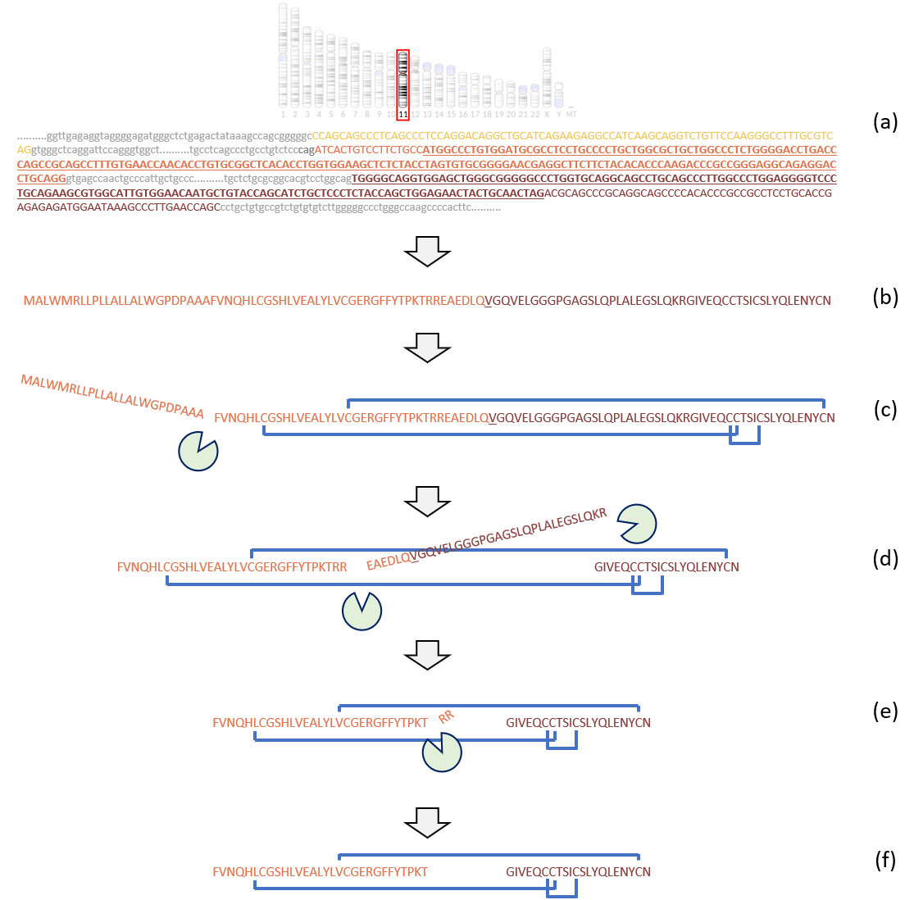

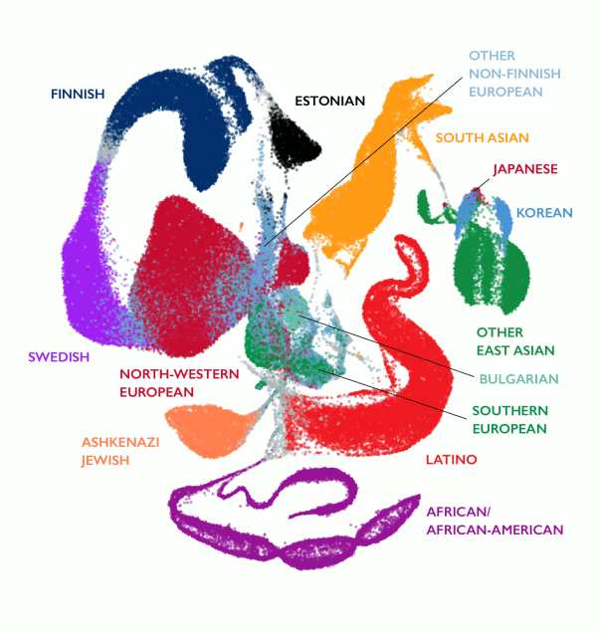
From genes to proteins and proteoforms
Where did you get protein sequences from?
3
Notes:
Illustration rom book chapter doi: 10.1039/9781788019880-00096 UMAP from gnomAD (gnomad.broadinstitute.org)

Slide 4
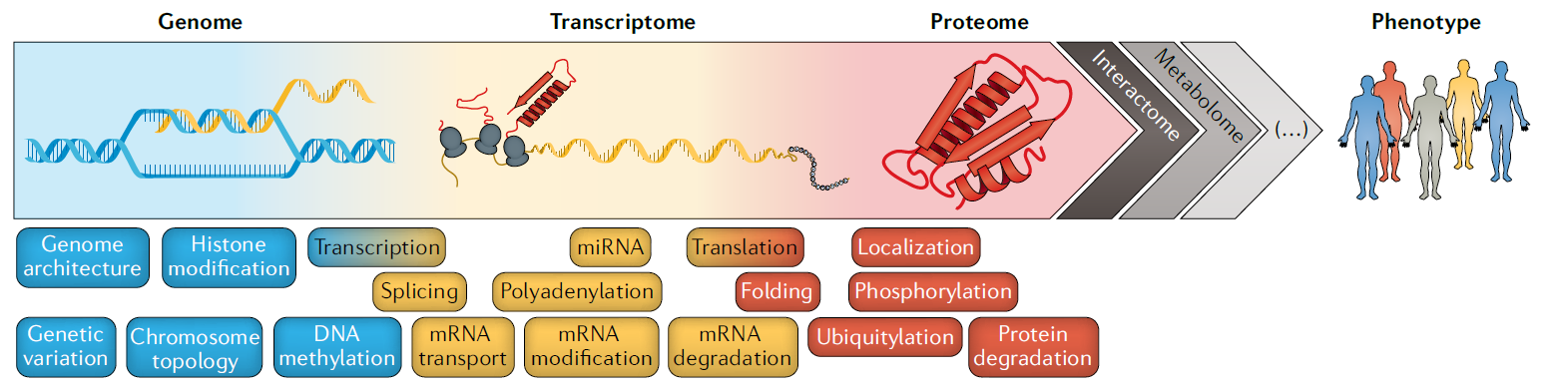

From genes to proteins
Proteogenomics: joint interpretation of genomics and proteomics data
Why would you want to combine genomics and proteomics data?
4

Slide 5
A clinical case study

Slide 6
A precision medicine success story?
Frazier et al., Fatal Perinatal Mitochondrial Cardiac Failure Caused by Recurrent De Novo Duplications in the ATAD3 Locus doi.org/10.1016/j.medj.2020.06.004

Slide 7

An extraordinary claim requires extraordinary proof
N = 16
Trio WGS -> Duplication in ATAD3, phenotype similar to deletion of ATAD3
Mined other cases in WGS, WES and array, verified with >3 pipelines.

Slide 8
An extraordinary claim requires extraordinary proof
N = 16
Trio WGS -> Duplication in ATAD3, phenotype similar to deletion of ATAD3
Mined other cases in WGS, WES and array, verified with >3 pipelines.
Trio PCR + Sanger sequencing of the chimeric gene

Slide 9
An extraordinary claim requires extraordinary proof
N = 16
Trio WGS -> Duplication in ATAD3, phenotype similar to deletion of ATAD3
Mined other cases in WGS, WES and array, verified with >3 pipelines.
Trio PCR + Sanger sequencing of the chimeric gene
Lines + transcriptomics + Sanger sequencing of the chimeric transcript
Mass spectrometry proteomics

Slide 10
An extraordinary claim requires extraordinary proof
N = 16
Trio WGS -> Duplication in ATAD3, phenotype similar to deletion of ATAD3
Mined other cases in WGS, WES and array, verified with >3 pipelines.
Trio PCR + Sanger sequencing of the chimeric gene
Lines + transcriptomics + Sanger sequencing of the chimeric transcript
Mass spectrometry proteomics
Mechanism

Slide 11
Towards routine proteogenomics
What are the odds?
Do the data make the story or does the story make the data?
How many experts do you need to run a proteogenomics project?
Can this be done at scale?
Are we allowed to do it?
doi.org/10.1038/s41576-020-0258-4

Slide 12
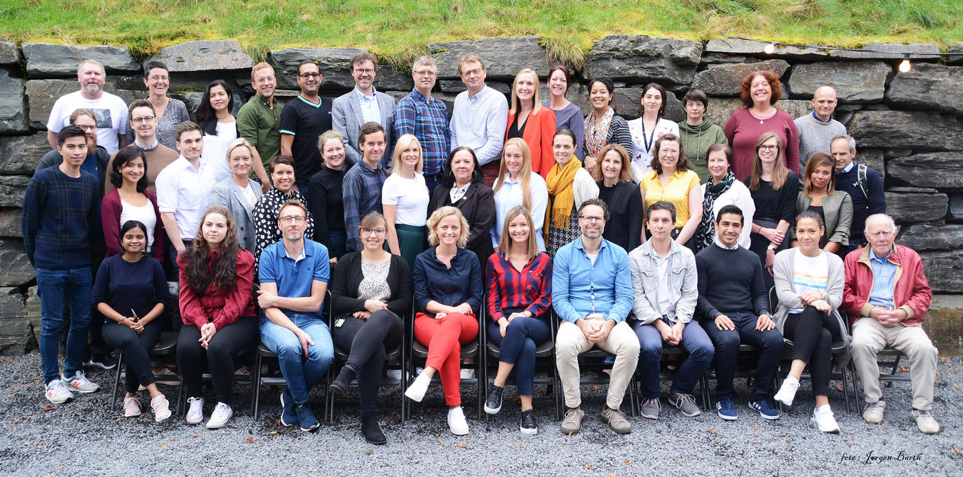


Acknowledgement

